Slide 1

Verb Sense Induction using Phrase Embeddings
LING 7800
Computational Lexical Semantics
Dan Prendergast and Sam Young

Slide 2


The Problem
Polysemy!
Word Sense Disambiguation (WSD) is still an open problem
Knowledge-based and supervised approaches to WSD require manual labeling
Wordnet
Unsupervised approaches can’t identify a particular sense. They can only identify that different senses exist
Word Sense Induction (WSI)
We didn’t solve any of these problems, BUT…
“build a house”
vs.
“build confidence”

Slide 3
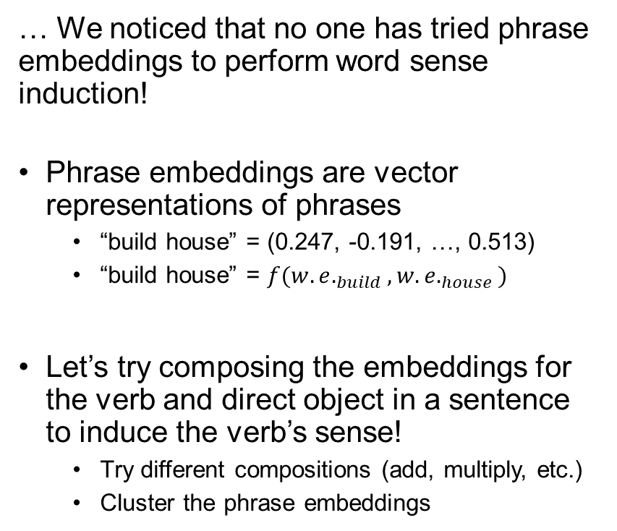
Inspiration
“build house”
… We noticed that no one has tried phrase embeddings to perform word sense induction!
Phrase embeddings are vector representations of phrases
“build house” = (0.247, -0.191, …, 0.513)
“build house” = $f(w.e._{build}, w.e._{house})$
Let’s try composing the embeddings for the verb and direct object in a sentence to induce the verb’s sense!
Try different compositions (add, multiply, etc.)
Cluster the phrase embeddings
(0.247, -0.191, …, 0.513)
“build car”
“build bridge”
“build house”
build.01
“build business”
build.02
“build confidence”
“build loyalty”

Slide 4
The Research Question
Can we compose word embeddings for verb-object pairs to induce different senses of a verb?
Which composition methods most induce different verb senses?

Slide 5
The Approach
Extract verb-object pairs and the true verb sense from Propbank
Calculate phrase embeddings
Perform k-means clustering on phrase embeddings
Find optimal alignment of verb senses to clusters
Evaluate embedding sets and composition methods

Slide 6
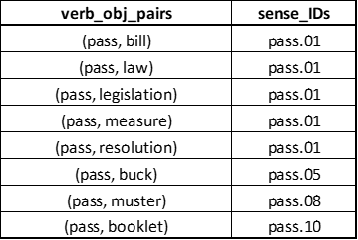
PropBank Data Extraction
Resources:
NLTK library in Python
PropBank/Treebank datasets in NLTK
Procedure:
For sentences with an Arg1, record the predicate (lemma), verb sense, and Arg1
Find sets of verbs showing >1 sense
Manually annotate the direct object
Delete duplicates of verb-object pairs
Result:
219 verb-object pairs
28 verbs
7.8 unique objects per verb
`` The First Amendment proscribes the government from passing laws abridging the right to free speech,'' Judge Donald O'Brien ruled.
Predicate (lemma): pass
Verb Sense: pass.01
Arg1: (NP (NP (NNS laws)) (VP (VBG abridging) (NP (NP (DT the) (NN right)) (PP (TO to) (NP (JJ free) (NN speech))))))
Direct Object (lemma): law

Slide 7



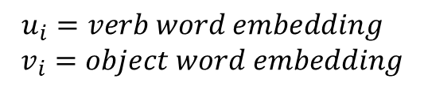
Calculate Phrase Embeddings
Pre-trained word embeddings:
GloVe trained on Wikipedia
word2vec trained on Google News
Calculation of phrase embeddings:
Addition
Multiplication
Combined
Result:
2 embedding sets x 3 compositions = 6 phrase embedding sets
$$u_{i}=verb word embedding$$
$$v_{i}=object word embedding$$
…

Slide 8
K-means Clustering
Perform K-means Clustering on the phrase embeddings
K is determined by the number of true sense_IDs in the PropBank data for each verb
For example, the PropBank data had four senses for “pass”:
pass.01
pass.05
pass.08
pass.10
“pass law”
“pass legislation”
“pass measure”
Cluster 0
“pass bill”
Cluster 1
Cluster 3
“pass resolution”
“pass booklet”
“pass muster”
Cluster 2
“pass buck”

Slide 9
Align Senses to Clusters
An alignment is an assignment of each of a predicted sense_IDs to one of the clusters
Best alignment determined by highest percentage of predicted sense_IDs that match true sense_IDs
Example Alignment:
Cluster 0 = sense_ID pass.01
Cluster 1 = sense_ID pass.05
Cluster 2 = sense_ID pass.08
Cluster 3 = sense_ID pass.10
6 of 8 senses properly predicted

Slide 10
The Evaluation
Word2vec - Multiplication
Independent Variables
Word Embedding Set – 2 Levels
Composition Method – 3 Levels
2 x 3 Factorial Design…
Dependent Variable
Sense assignment accuracy
Accuracy = 60.3%

Slide 11
Results and Discussion
Not amazing, but better than chance.
Combination method of composing vectors outperformed the other methods.
We expected the embeddings trained on Google News to beat embeddings trained on Wikipedia.
* Baseline determined by random assignment of each verb-obj pair to one of the true sense_IDs for that verb.

Slide 12
Questions?

